Slide 1

BigMart Sales Prediction
Tolu Agunbiade
Nov 2021

Slide 2
Introduction
The objective of this project is to build a model to predict the expected sales of some selected products from BigMart store locations.
The premise for building this model is that predicting the expected sales of the products based on the model will be useful in making business decisions such as the best location to build or lease a store, which products to sell in which stores and what the size mix of the stores in the property portfolio should be.
The analysis and models built in this projects are largely experimental, and the expectation is that some work would still have to be done to make the model production-ready.
However, the result from this project is promising as it demonstrates that predicting the sales of products (albeit, subject to varying, but reliable degrees of accuracy) from available sales data is feasible

Slide 3
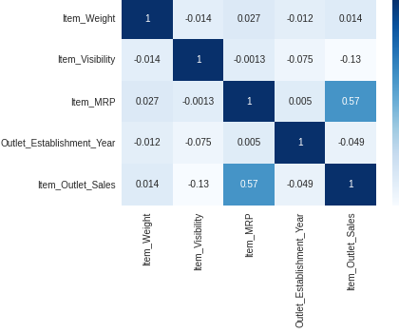
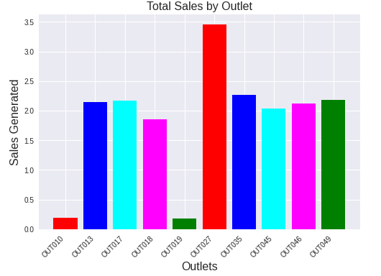
Data Analysis and Insight
Fig. 1: Data Correlation
Fig. 2: Total Sales by Outlet
Data Description
The data for this project contains about 8500 rows and 12 columns. It represents sales data for 1559 unique products taken from 10 stores of various sizes across the country.
As shown in Fig. 1 above, the outlet sales for the products has a relatively strong correlation with the product price (0.57), but do not have a strong correlation with any of the other variables
Fig. 2 above also shows that Outlet027 generated the biggest total sales for all the products analyzed

Slide 4
Model Building and Evaluation
A Linear Regression model and a Decision Tree Regression model were built to predict the product sales. The purpose of building two models is so that the performance can be compared to enable us order to choose the best model. The performance of both models are shown below:
*Note: R² describes how well the data explains the variability we’ve observed in the variable we’re trying to predict, higher this number the better, while RMSE is a measure of deviation from our prediction to the actual values. The lower the RMSE the better.
Fig. 3: Model Performance Comparison
Metrics* | Linear Regression | Decision Tree Regression
R² | 0.578 | 0.611
Root Mean Squared Error (RMSE) | $1,070.95 | $1,027.74

Slide 5
Conclusion and Recommendation
Based on the metrics for the models, I will recommend that the Decision Tree model be deployed.
From the model metrics, the RMSE of the decision tree model at USD1027.74 is lower than that of the linear regression model at USD1070.95. This means that the deviation of the predicted values from the actual values is smaller and therefore better with the decision tree model than with the linear regression model.
Additionally, the R2 score on the test set for the decision tree model at 0.611 is higher than that of the linear regression model at 0.578. This means that decision tree model does a better job of explaining the variability in sales (target variable) given the independent variables than the linear regression model.

